Slide 1
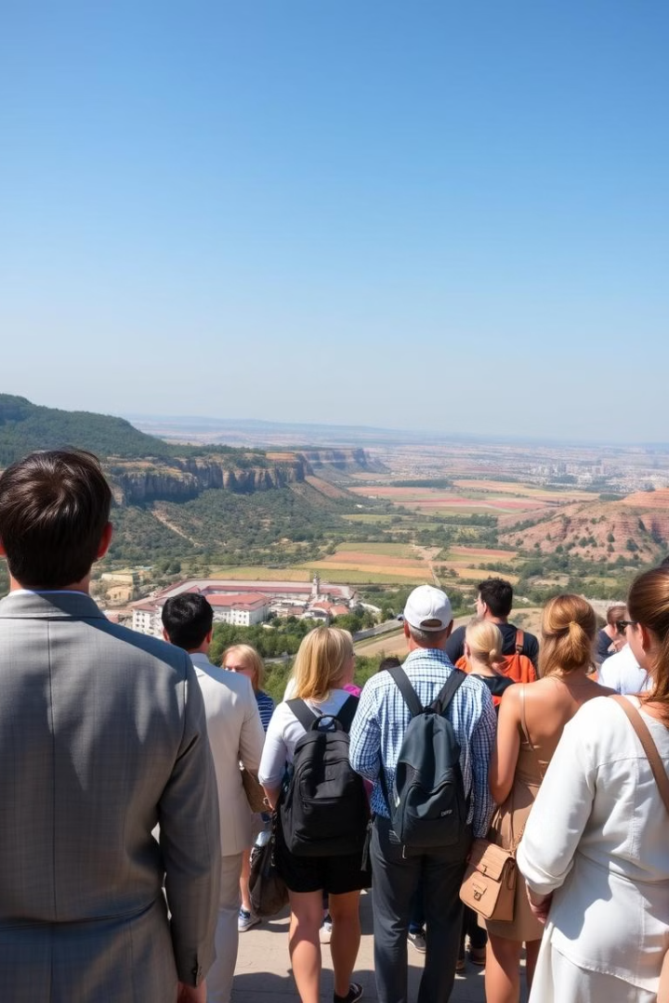

MIS for Tourism & Travel Agency
By
Deendhayal RR - 192110001
Kathiravan - 192110445

Slide 2





Introduction
The Management Information System (MIS) for Tourism & Travel Agency Management is a smart, data-driven solution designed to streamline tour package management, customer bookings, and itinerary generation. This system provides real-time insights into travel trends, revenue analytics, and customer preferences, helping travel agencies optimize their offerings and improve customer experience.
Comprehensive System
Real-Time Insights
Customer Experience
Data-Driven
Provides revenue analytics and seasonal trends.
Enhances experience with automated itineraries.
Uses DBMS, BI, and SQL for decision-making.
Handles tour packages, bookings, and itineraries.

Slide 3



Problem Statement
Manual Inefficiencies
Lack of Automation
Missing Insights
Manual tour package management is inefficient.
No automation in itinerary generation.
No real-time insights into travel trends.

Slide 4
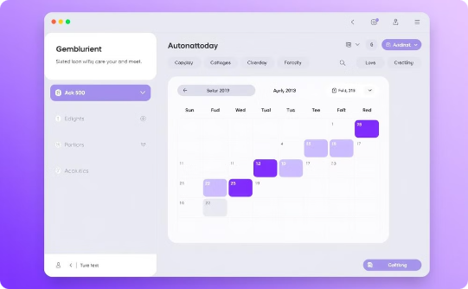
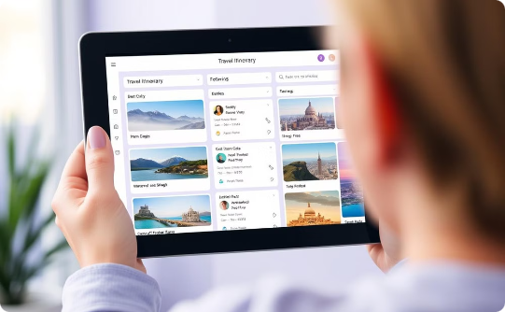
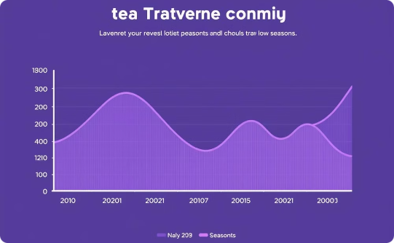
Objectives
Automate Bookings
Personalized Itineraries
Trend Analysis
Streamline customer bookings with an efficient, automated system.
Offer tailored itineraries based on individual package selections.
Deliver insights into revenue and seasonal travel patterns.

Slide 5
System Requirements
Hardware
Software
Cloud servers
OS: Windows/Linux/macOS
User devices
Languages: JavaScript, Python
Database: MySQL / PostgreSQL
Visual Studio Code

Slide 6
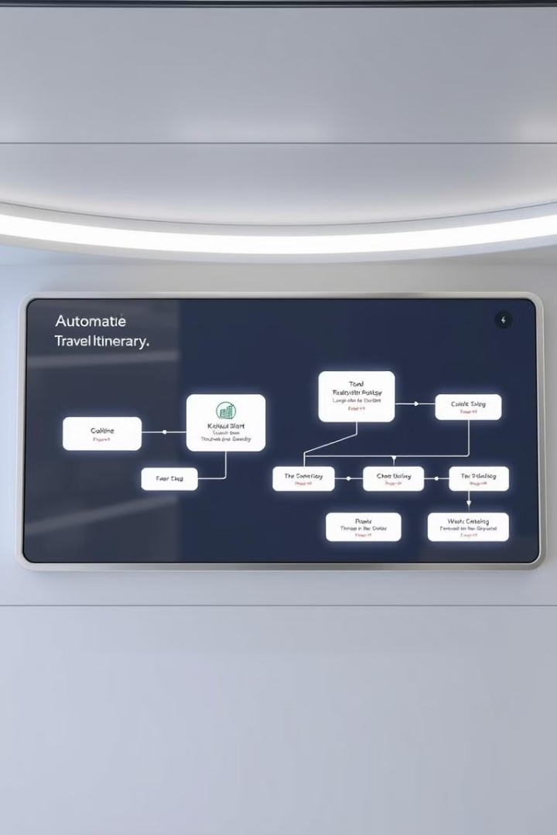
Functional Requirements
1
Package Management
Tour package creation and management.
2
Booking & Payment
Customer booking and payment processing.
3
Itinerary Generation
Automated itinerary generation.

Slide 7




Non-Functional Requirements
Scalability
Handles 1,000+ bookings simultaneously.
Performance
Fast response times for queries & reports.
Security
Secure authentication & encrypted transactions.

Slide 8




Inputs & Data Flow
Customer Details
Booking Requests
Payment Details
Agent Updates
Initial customer information is inputted.
Customers submit requests for bookings.
Payment information is processed.
Agents update the system.

Slide 9
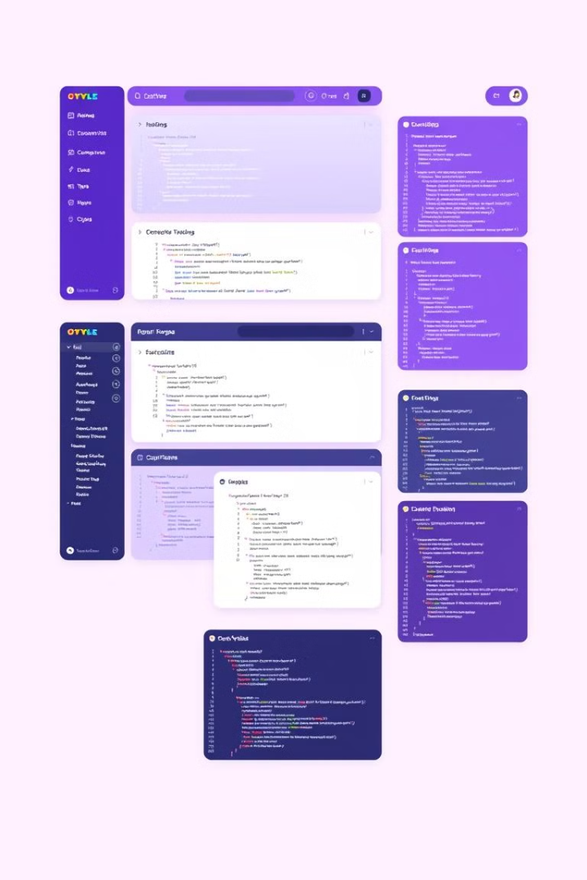
Frontend Development
1
Framework
React.js
2
UI Design
HTML / CSS / Bootstrap for responsive design.
3
State Management
Context API for efficient data flow.
4
API Integration
Axios / GraphQL for seamless data retrieval.

Slide 10

Backend Development
Framework
Node.js + Express.js for robust server logic.
Database
MySQL / PostgreSQL for scalable data storage.
Authentication
JWT / OAuth for secure user access.
APIs
RESTful APIs for real-time data handling.

Slide 11




Architecture Design
Frontend
Backend
Database
HTML, CSS, Java Script
Node.js
MySQL/PostgreSQL

Slide 12
Database Design & Schema
Users Table
Tour Packages Table
Bookings Table
(id, name, role, email, password)
(package_id, destination, price, itinerary_details)
(booking_id, customer_id, package_id, status, payment_details)

Slide 13
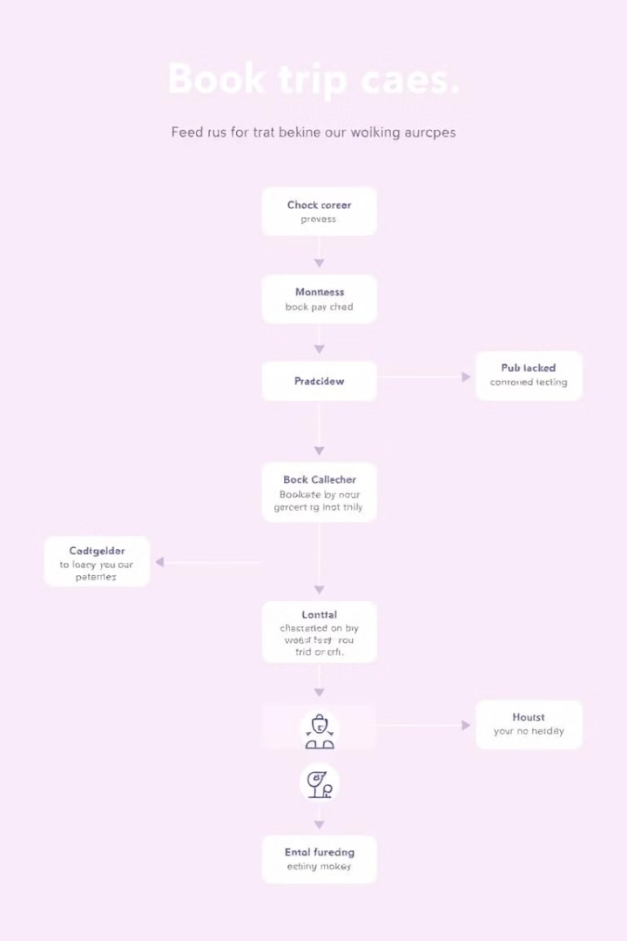
Flow Diagram
1
Customer Selects
Tour package, system logs request.
2
Payment Processed
Booking confirmation sent.
3
Itinerary Generated
Shared with the customer.

Slide 14
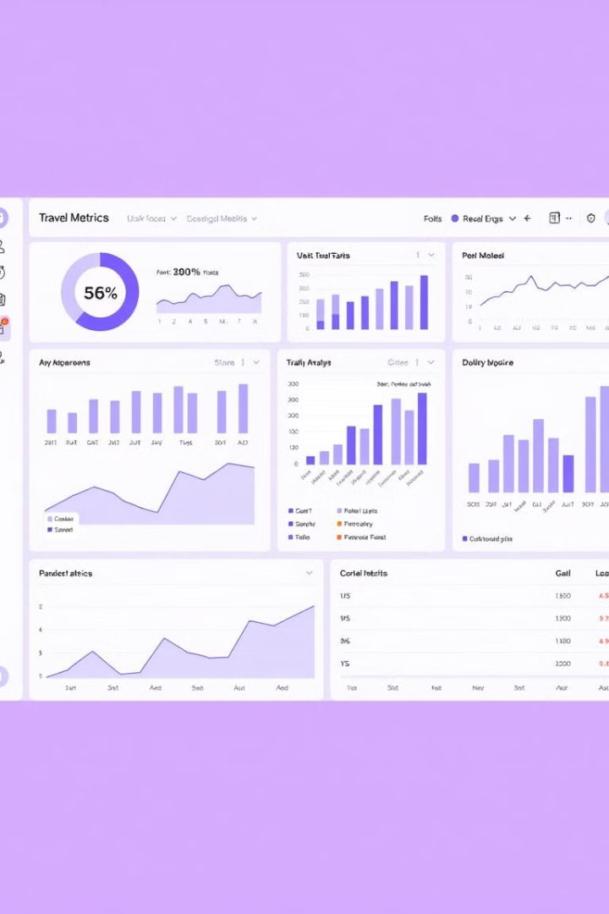



Revenue Analytics & Seasonal Trends
Peak Season Reports
Customer Analysis
Growth Trends
Yearly/monthly insights.
High-demand destinations.
Age, preferences, spending.

Slide 15




Testing & Debugging
Unit Testing
1
Integration Testing
2
4
Security Testing
3
Performance Testing

Slide 16
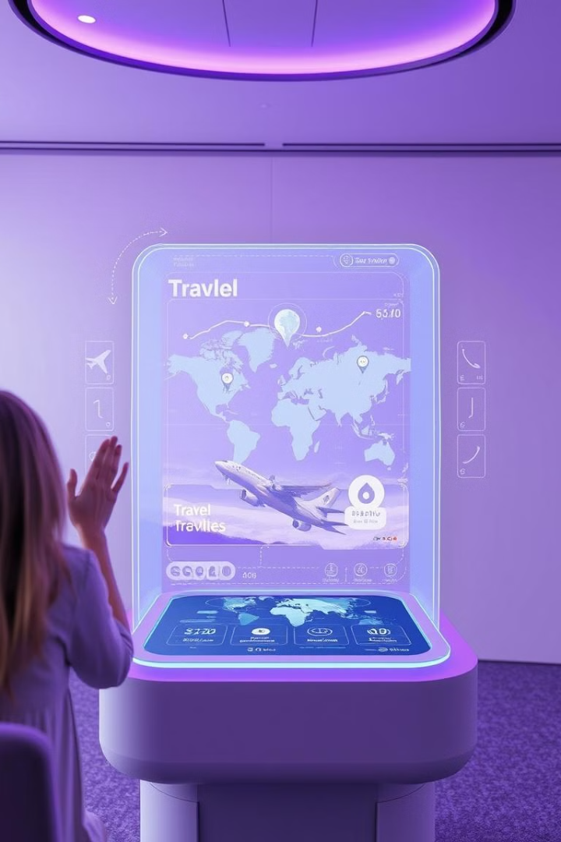
Future Enhancements
Dynamic Pricing
API Integration
AI-driven pricing for tour packages.
Flights, Hotels, Car Rentals.
Augmented Reality
Virtual Travel Previews.

Slide 17
Thank you

